Slide 1
Case Study 2 - DDS Analytics
Arturo Max Pagan

Slide 2
Presentation Agenda
Discussion of the Available Data
Discussion of the Attrition Prediction Model
Top Attrition Predictors
Conclusion

Slide 3
Discussion of Available Data
Exploring Relationships between data points
Visual tools - Scatterplots
Statistical tests - T-Test
Attrition rates by variable

Slide 4
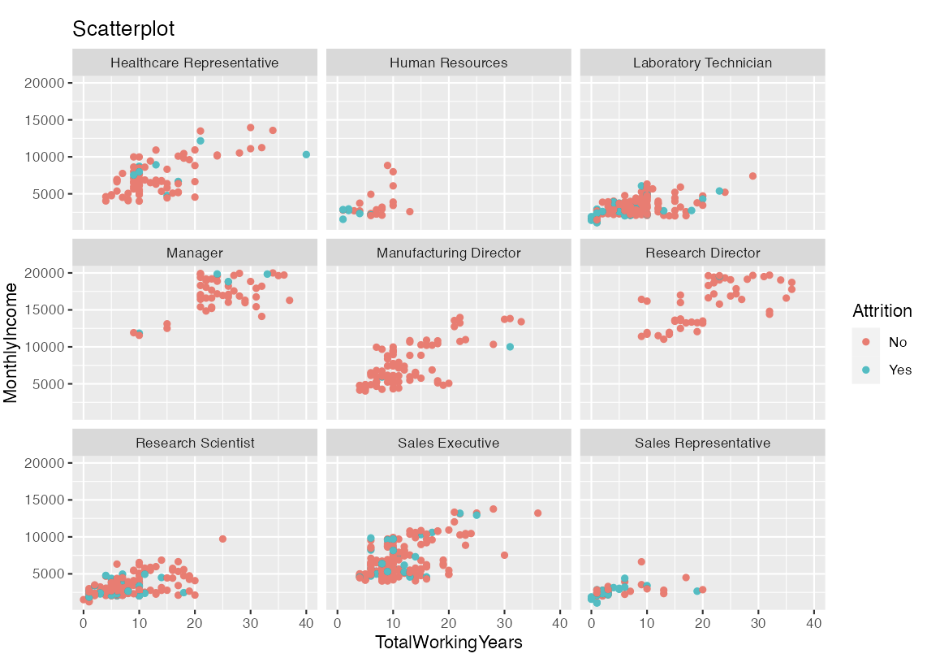
Visual tools - Scatterplots

Slide 5
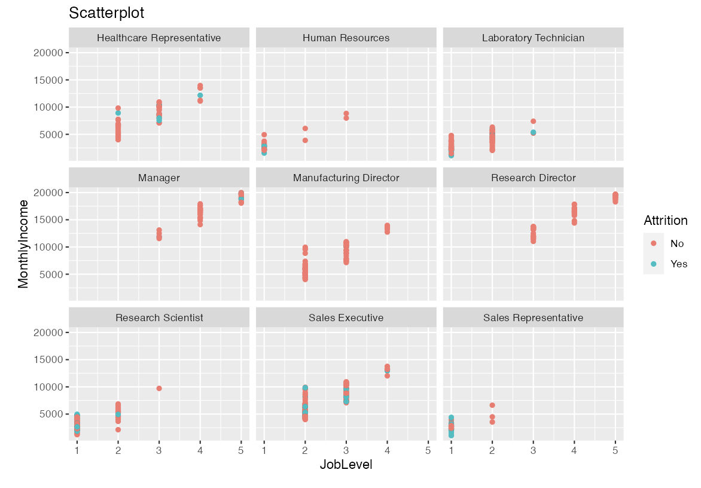
Visual tools - Scatterplots

Slide 6
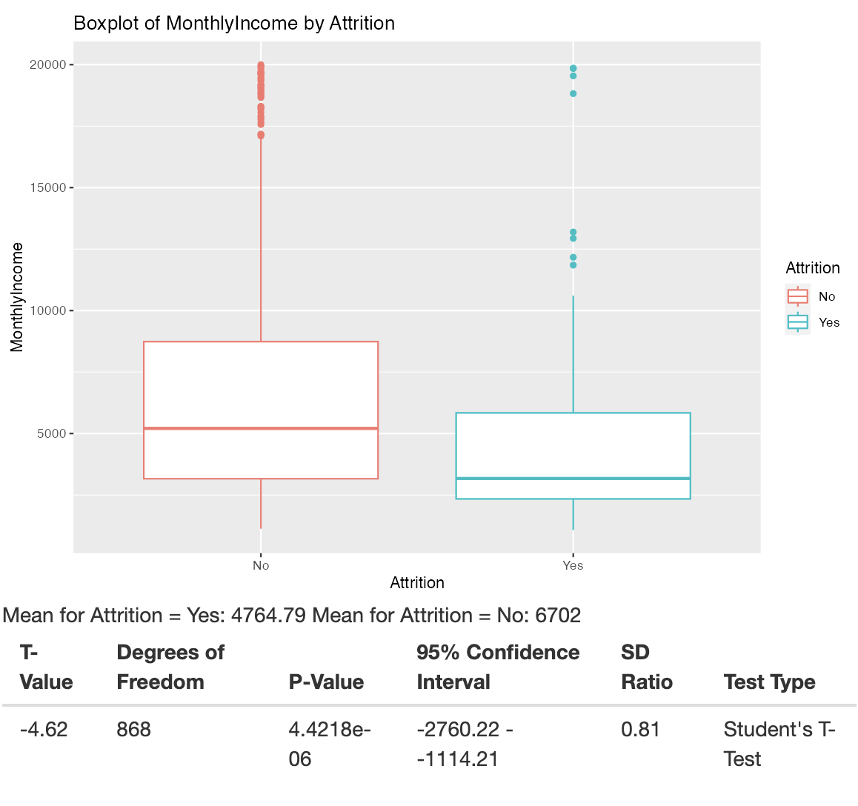
Statistical tests - T-Test
With 95% confidence, we can say that the mean monthly income is between $1,114 and $2,760 LOWER for employees who left
Strong implications for Monthly Income’s ability to predict Attrition
We can do this for all numerical variables

Slide 7
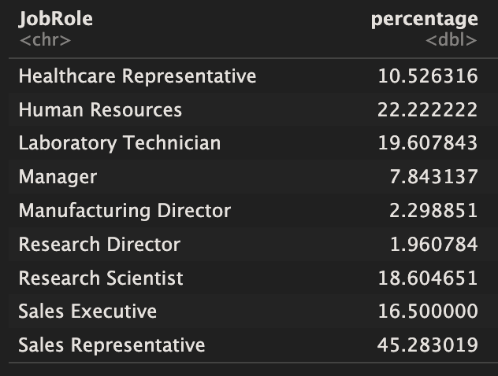
Attrition Rates Per Variable
45% of Sales Reps ended up leaving, but only 1.9% of Research Directors
Speaks to the job role’s ability to predict attrition
Other categorical variables yield similar telling results - overtime, marital status

Slide 8
Discussion of the Attrition Prediction Model
Naive Bayes classification - uses probabilities based on the given data
Uses numerical variables like monthly income as well as categorical variables to maximize sensitivity (true stay) and specificity (true leave rates) above required threshold
Specificity - 0.6551 - correctly predicts an employee will leave
Sensitivity - 0.8 - correctly predicts an employee will stay

Slide 9
Top Attrition Predictors
Top 3 predictors for employee attrition are:
JobRole
JobInvolvement
Age
The only variables with any predictive power alone

Slide 10
Conclusion
Developed a strong understanding of the factors of talent management
Variables don’t exist in a vacuum
Understanding talent means understanding how these factors interact

Slide 11
Thank you!

